Slide 1
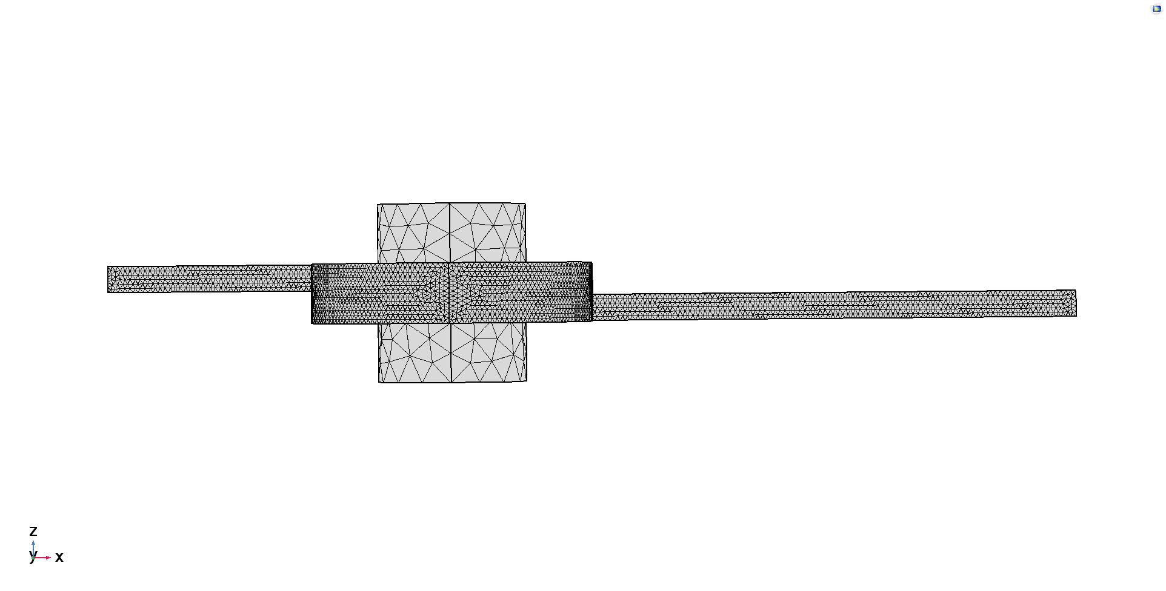

Slide 2
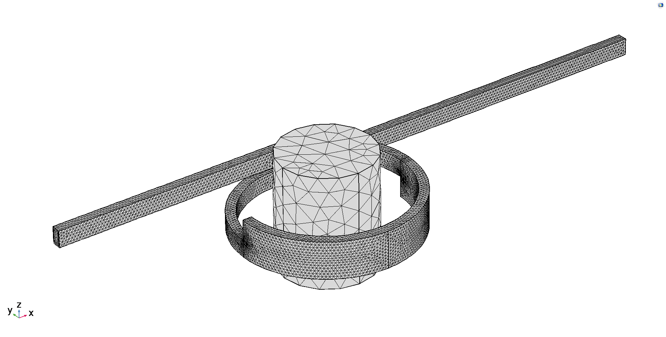
Outlet:
1 atm
Wall condition: No slip
Magnetic Flux Conservation
Inlet:
12 ml/min
600 particles
Magnetic Permeability µi:
Fluid = 1
Air = 1
Particles = 5000

Slide 3
